Slide 1
Project presentation: Date and time clock
Cesmeli ibrahim mert, Dussol Guillaume

Slide 2
Project itself
The project goal is to make an application with:
Time
Date
Alarms
Chronometer
Timer

Slide 3
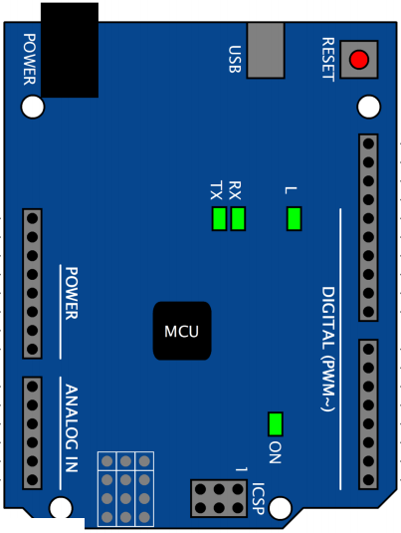
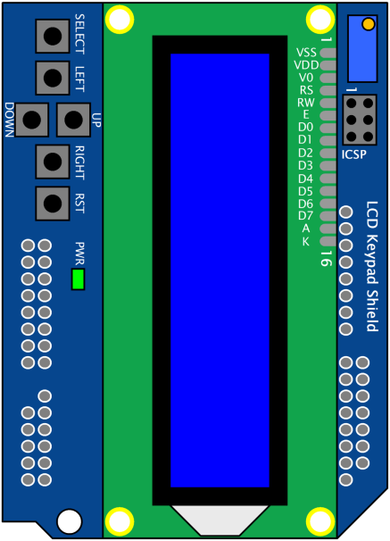
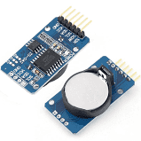
Material used
Arduino Uno target board with ATmega328/P microcontroller
LCD Keypad Shield
DS3231 RTC clock

Slide 4
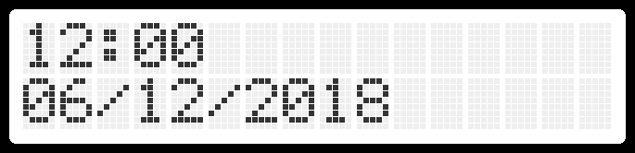
Current state of the project
Get and display date and time
Interactive menu
Set time / date

Slide 5
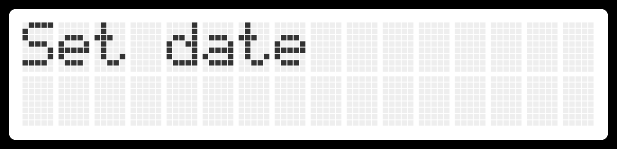
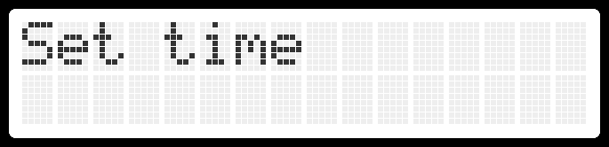
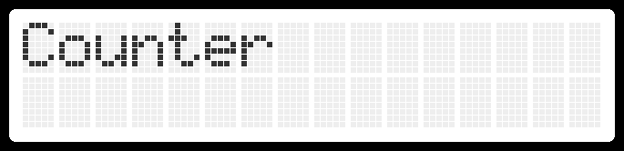
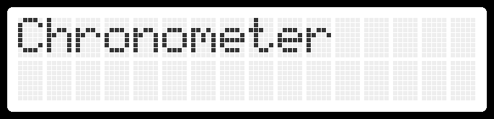
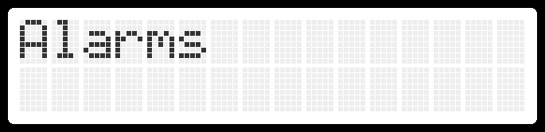
Interactive menu

Slide 6
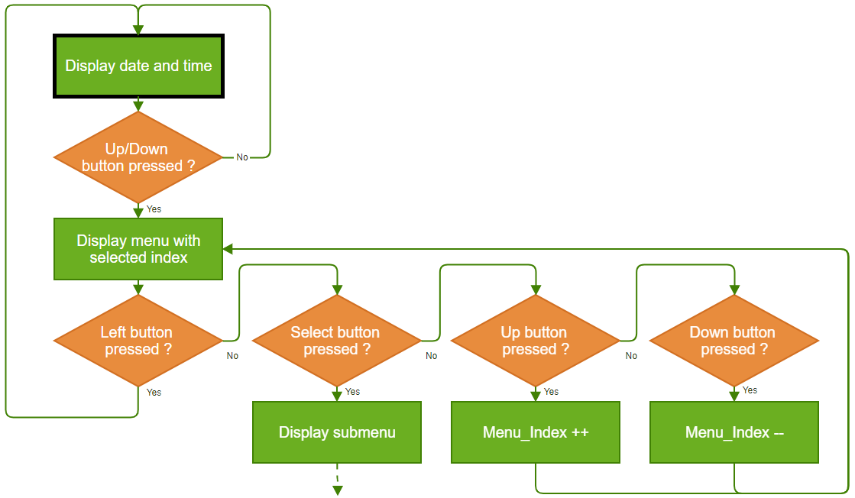
Interactive menu

Slide 7
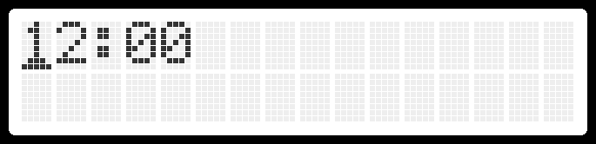

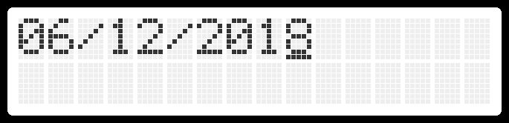
Set time / date

Slide 8
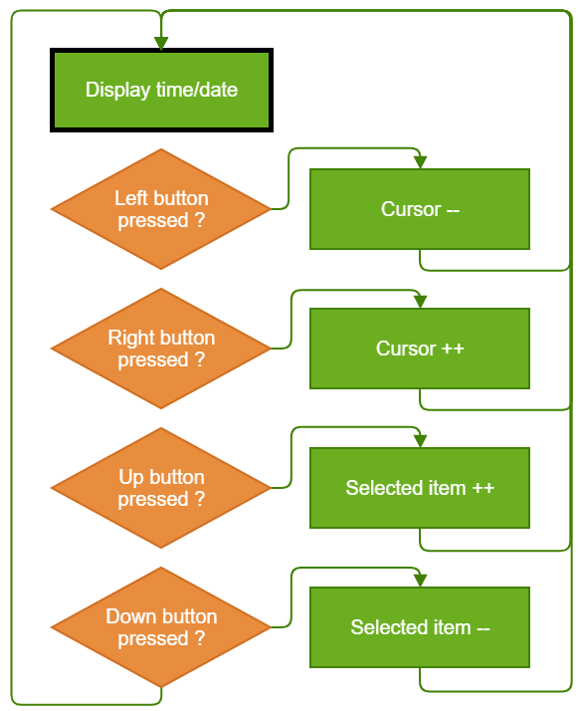
Set time / date

Slide 9
Demo
https://youtu.be/dkUYMvdTPwQ

Slide 10
What we would like to do
Use EEPROM to store and load date, time and alarms
Alarms
Chronometer
Timer

Slide 11
Thanks for your attention

